Slide 1




TRENDS IN COMPUTER SCIENCE
4COSC008C.2
QUANTUM COMPUTING

Slide 2

OUR TEAM
Saad Mazhar
W2053223
Ahamed Aathif
W2053156
Jithnuka Athurugiriya
W2053222
Thanzeel Kaiff
W2053212
Huzrin Hussain
W2053220

Slide 3

CONTENT
01
WHAT IS QUANTUM COMPUTING?
02
QUANTUM COMPUTING VS VON NEUMANN ARCHITECTURE
03
OPPOTUNITIES THAT QUANTUM COMPUTING BRINGS
04
ADOPTING TO NEW COMPUTER TRENDS
05
IMPACT ON COMPUTER SECURITY
06
BENEFITS OF QUANTUM COMPUTING

Slide 4

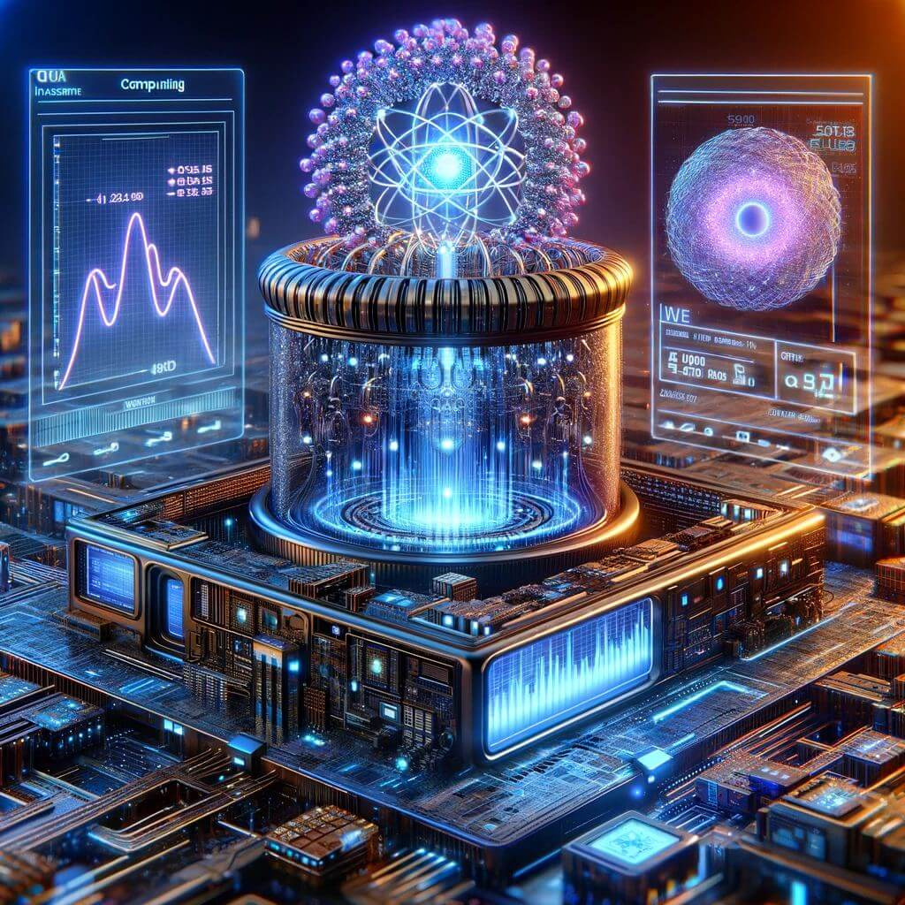
WHAT IS QUANTUM COMPUTING?
  Quantum Computing is a cutting-edge computational approach based on the principles of quantum mechanics. It utilizes qubits, which can exist in multiple states simultaneously.
  This enables highly efficient parallel processing, enhanced by entanglement, connecting qubits regardless of physical distance.
  Quantum Computing has transformative potential in cryptography, optimization, simulations, and machine learning, positioning it as a frontier in information technology despite being in its early stages of development.
04

Slide 5
QUANTUM COMPUTING VS VON NEUMANN ARCHITECTURE
 | Conventional Computing | Quantum Computing
Memory & Storage | Separates memory and processing. | Allows both storage and processing together.
Data Speed | May have bottlenecks in speed. | Potential to be faster, overcoming limits.
Error Correction | Uses established techniques. | Research Ongoing.
Information Processing | Follows predictable rules. | Bringing new possibilities.
05

Slide 6
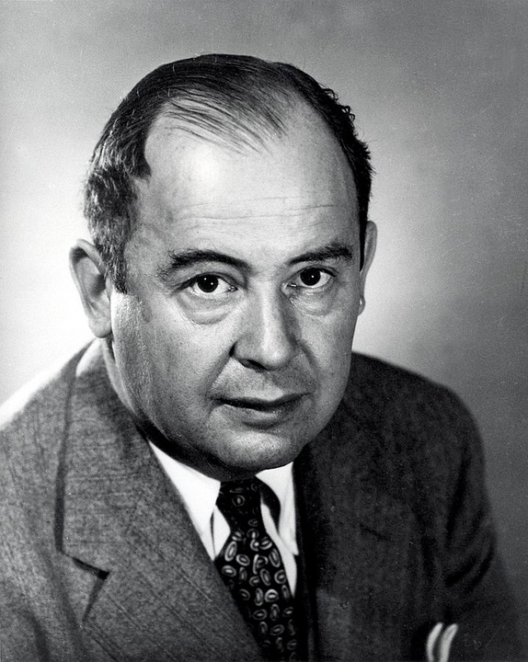
WHAT IS VON NEUMANN ARCHITECTURE?
  Von Neumann Architecture is a design framework for computers, proposed by mathematician and physicist John von Neumann in 1945.
  Von Neumann Architecture comprises components that form the backbone of classical computers. [The Central Processing Unit (CPU), Memory (RAM), Control Unit & Arithmetic Logic Unit (ALU)]
  Advantages:
- Simplicity in design.
- Flexibility in program storage and execution.
John Von Neumann
(1945)
06

Slide 7
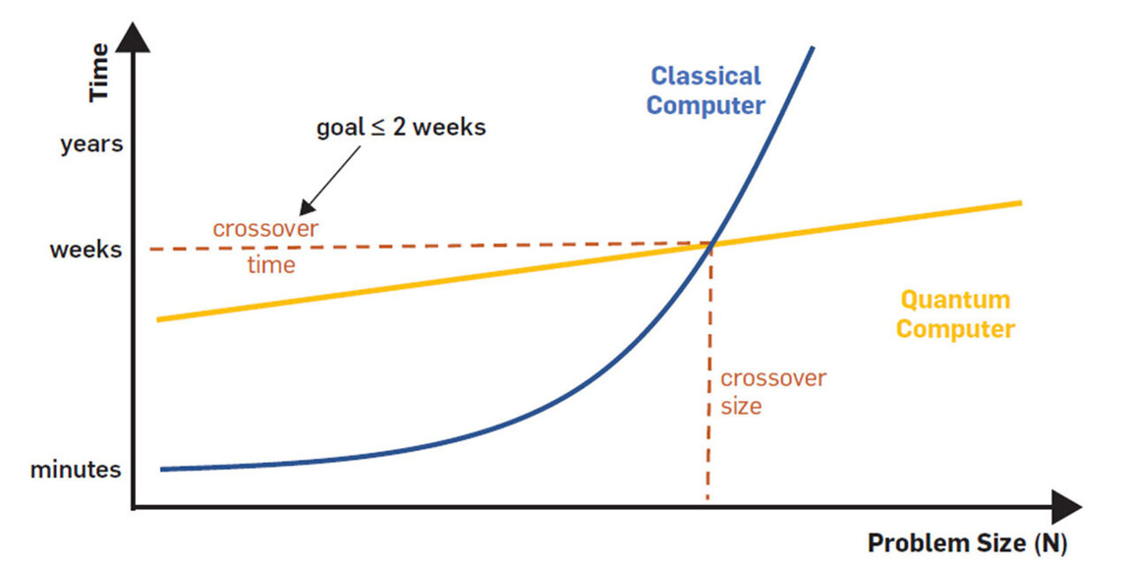
MEMORY AND STORAGE
CONVENTIONAL COMPUTING
QUANTUM COMPUTING
In Von Neumann architecture, memory (RAM) and processing (CPU) operate as separate entities, requiring a sequential flow for data transfer and execution.
Quantum Computing uniquely allows for both storage and processing to occur simultaneously, a distinctive feature stemming from the principle of superposition.
07

Slide 8
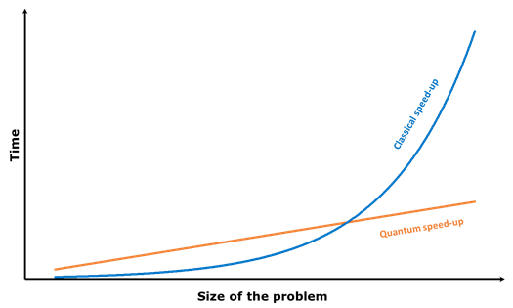
DATA SPEED
CONVENTIONAL COMPUTING
QUANTUM COMPUTING
The potential emergence of bottlenecks in speed is a recognized challenge.
This occurs due to the sequential nature of operations, where data retrieval and processing may face limitations in terms of speed and efficiency.
Quantum computers have the potential to achieve faster processing speeds, effectively overcoming the limits imposed by the sequential nature of conventional computing.
08

Slide 9
ERROR CORRECTION
CONVENTIONAL COMPUTING
QUANTUM COMPUTING
Error correction relies on well-established techniques.
These proven methods are integral to ensuring the accuracy and reliability of computations.
The landscape of error correction is currently under active exploration and research.
Ongoing efforts are dedicated to developing robust algorithms to address the unique challenges posed by quantum decoherence and errors in quantum systems.
09

Slide 10
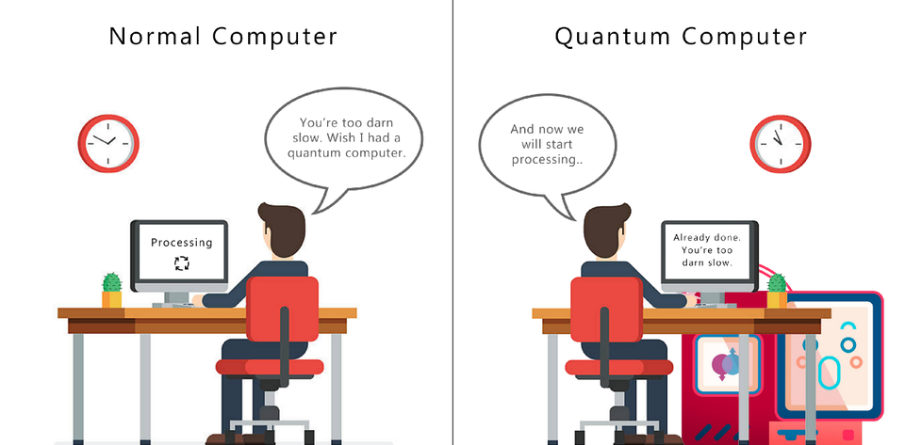
INFORMATION PROCESSING
CONVENTIONAL COMPUTING
QUANTUM COMPUTING
Information processing adheres to predictable rules.
This deterministic approach ensures consistent and expected outcomes in data manipulation and computational tasks.
Quantum Computing introduces a realm of unprecedented possibilities in information processing.
By embracing probabilistic principles and leveraging the unique attributes of qubits, quantum computers offer a departure from the predictability of classical systems, opening avenues for innovative solutions to complex problems.
10

Slide 11



PROPERTIES OF QUANTUM COMPUTING
SUPERPOSITION
ENTANGLEMENT
INTERFERENCE
Any two quantum states can be summed up.
Strong correlation between two quantum particles.
When two waves interact with each other in same medium.
11

Slide 12



NEW OPPORTUNITIES
DRUG DISCOVERY
CLIMATE MODELING
CRYPTOGRAPHY
12

Slide 13
DRUG DISCOVERY
Molecular Stimulation
Speeds up the process of finding new medications
Drug design and Optimization
Researchers may customize medications with greater effectiveness and less side effects.
Virtual screening and Optimization
Compounds can be virtually screened to find substances with specific pharmacological characteristics.
13

Slide 14

CLIMATE MODELING
High-Resolution Simulation
Complex climate simulations can be carried out.
Quantum Machine Learning for Climate Analysis
Large climatic datasets may be analyzed.
Optimization of Climate Mitigation Strategies
14

Slide 15
CRYPTOGRAPHY
Post-Quantum Cryptography
Have the ability to bypass traditional encryption systems.
Quantum Key Distribution
Provides provably secure communication channels.
Random Number Generation
Produces random numbers with high complexity.
15

Slide 16
FAMILIARISING WITH QUANTUM COMPUTING
Quantum Computing represents a transformative leap in computation.
Why is it crucial for computer scientists and software engineers to comprehend quantum computing?
Potential for Revolutionary Computing Power
Advancements in Technology and Research
Preparing for the Future
16

Slide 17

BCS CODE PRACTISE
The BCS Code of Practice is a comprehensive set of ethical guidelines and professional standards established by the British Computer Society (BCS) to govern the conduct of individuals working in the field of computing.
16

Slide 18
KEY PRINCIPLES OF THE BCS CODE OF PRACTICE
  01
  02
Public Interest and Duty to Society
Professional Competence and Integrity
  03
  04
Duty to Relevant Authorities
Professional Development
17

Slide 19


PURPOSE OF THE BCS CODE OF PRACTICE
  Ethical Foundation
  Maintaining Public Trust
  Adaptability and Responsiveness
  Professional Collaboration
18

Slide 20

IMPACT ON COMPUTER SECURITY
  Quantum computers are super fast, which can be both good and bad for security
  Good because they can help improve encryption methods, making data more secure.
19

Slide 21

IMPACT ON QUANTUM COMPUTING
  Quantum computers are incredibly fast and powerful.
  Quantum computers pose a threat to current encryption methods.
20

Slide 22
IMPACT ON ENCRYPTION
  Breaking existing encryption schemes
Quantum computers can solve complex mathematical problems much faster than traditional computers.
  Quantum Key Distribution (QKD)
(QKD) is a secure communication technique based on quantum science.
21

Slide 23



SECURE COMMUNICATION
  Digital signatures
They are created using cryptographic algorithms and are unique to each sender.
  Key Exchange
Key exchange is the process of securely sharing encryption keys between the communicating parties.
23

Slide 24
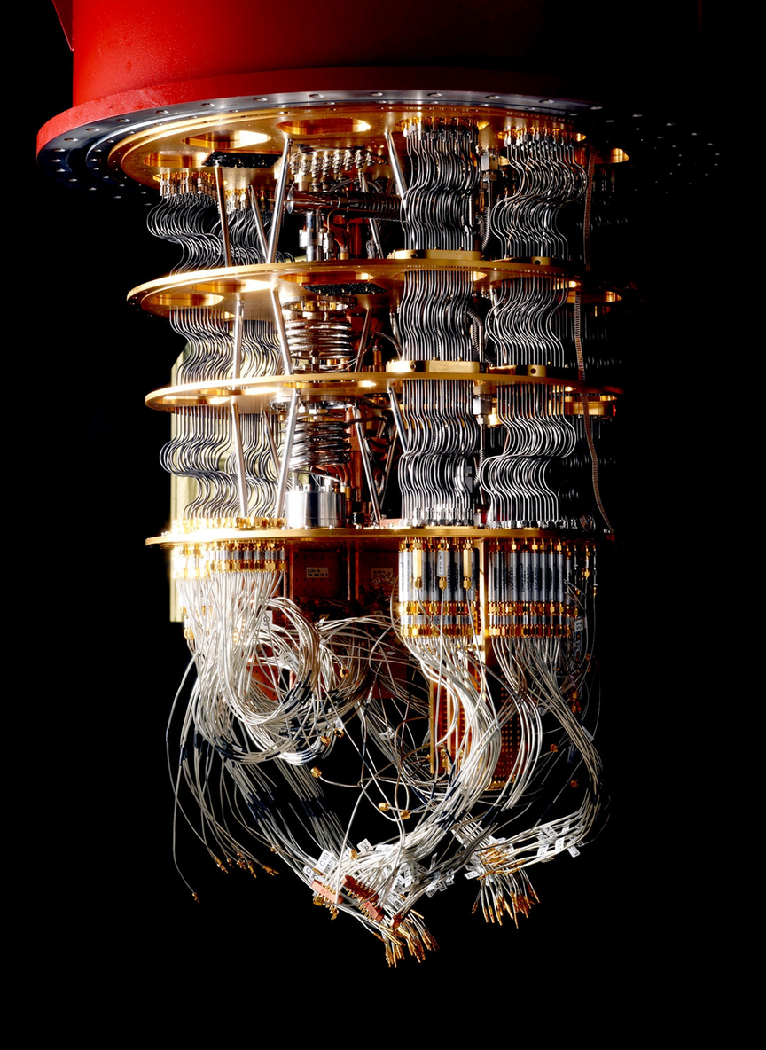
EXPLORING QUANTUM COMPUTING BENEFITS
  Quantum computing enables tackling complex optimization problems beyond conventional computers.
  Offers robust protection against eavesdropping and enhances digital security.
  Quantum computing reduces energy consumption compared to classical computers.
24

Slide 25
SOLVING COMPLEX OPTIMIZATION PROBLEMS
Offers unparalleled speed and scalability compared to classical computers.
  Quantum Annealing
Method to discover lowest energy state of a system, indicative of best solution.
  Grover's Algorithm
Quantum algorithm for searching unsorted databases.
25

Slide 26

SECURE COMMUNICATION
  Quantum Key Distribution
Ensures secrecy of encryption keys through quantum states encoding.
  Resistance to Attacks
Leveraging unique quantum properties provides resilience against classical and quantum threats.
26

Slide 27
INCREASED ENERGY EFFICIENCY
  Specialized Hardware Design
Quantum computing hardware can be optimized for energy efficiency.
  Efficient Data Processing
Unique characteristics of quantum states and operations enable streamlined data manipulations.
27

Slide 28
CONCLUSION

Slide 29

ANY QUESTIONS!?

Slide 30
REFERENCES
Surya Teja Marella and Sai, H. (2020). Introduction to Quantum Computing. [online] ResearchGate. Available at: Post-Quantum Cryptography Have the ability to bypass traditional encryption systems. Quantum Key Distribution Provides provably secure communication channels. Random Number Generation Produces random numbers with high complexity. [Accessed 27 Feb. 2024].
Zinner, M., Florian Dahlhausen, Boehme, P., Ehlers, J., Bieske, L. and Fehring, L. (2021). Quantum computing’s potential for drug discovery: Early stage industry dynamics. Drug Discovery Today, [online] 26(7), pp.1680–1688. doi: Post-Quantum Cryptography Have the ability to bypass traditional encryption systems. Quantum Key Distribution Provides provably secure communication channels. Random Number Generation Produces random numbers with high complexity. [Accessed 27 Feb. 2024].
Arodola, O.A. and Mahmoud Es Soliman (2017). Quantum mechanics implementation in drug-design workflows: does it really help? Drug Design Development and Therapy, [online] Volume 11, pp.2551–2564. doi: Post-Quantum Cryptography Have the ability to bypass traditional encryption systems. Quantum Key Distribution Provides provably secure communication channels. Random Number Generation Produces random numbers with high complexity. [Accessed 27 Feb. 2024].
Soronzonbold Otgonbaatar, Nurmi, O., Johansson, M. and Corneliu Octavian Dumitru (2023). Quantum Computing for Climate Change Detection, Climate Modeling, and Climate Digital Twin. [online] ResearchGate. Available at: Post-Quantum Cryptography Have the ability to bypass traditional encryption systems. Quantum Key Distribution Provides provably secure communication channels. Random Number Generation Produces random numbers with high complexity. [Accessed 27 Feb. 2024].
30

Slide 31
REFERENCES
Cem.D.2024. Quantum Annealing in 2024: Practical Quantum Computing.
https://research.aimultiple.com/quantum-annealing/ [Accessed 28 February 2024]
Ianurag.2023. Introduction to Grover’s Algorithm. https://www.geeksforgeeks.org/introduction-to-grovers-algorithm/ [Accessed 28 February 2024]
Moinuddin.Q, Swamit.T. 2021. Quantum Computing and the Design of the Ultimate Accelerator. IEEE Micro [Accessed 28 February 2024]
Tsai, Chia-Wei, et al.2021. Quantum Key Distribution Networks: Challenges and Future Research Issues in Security. https://www.mdpi.com/2076-3417/11/9/3767[Accessed 28 February 2024]
31

Slide 32



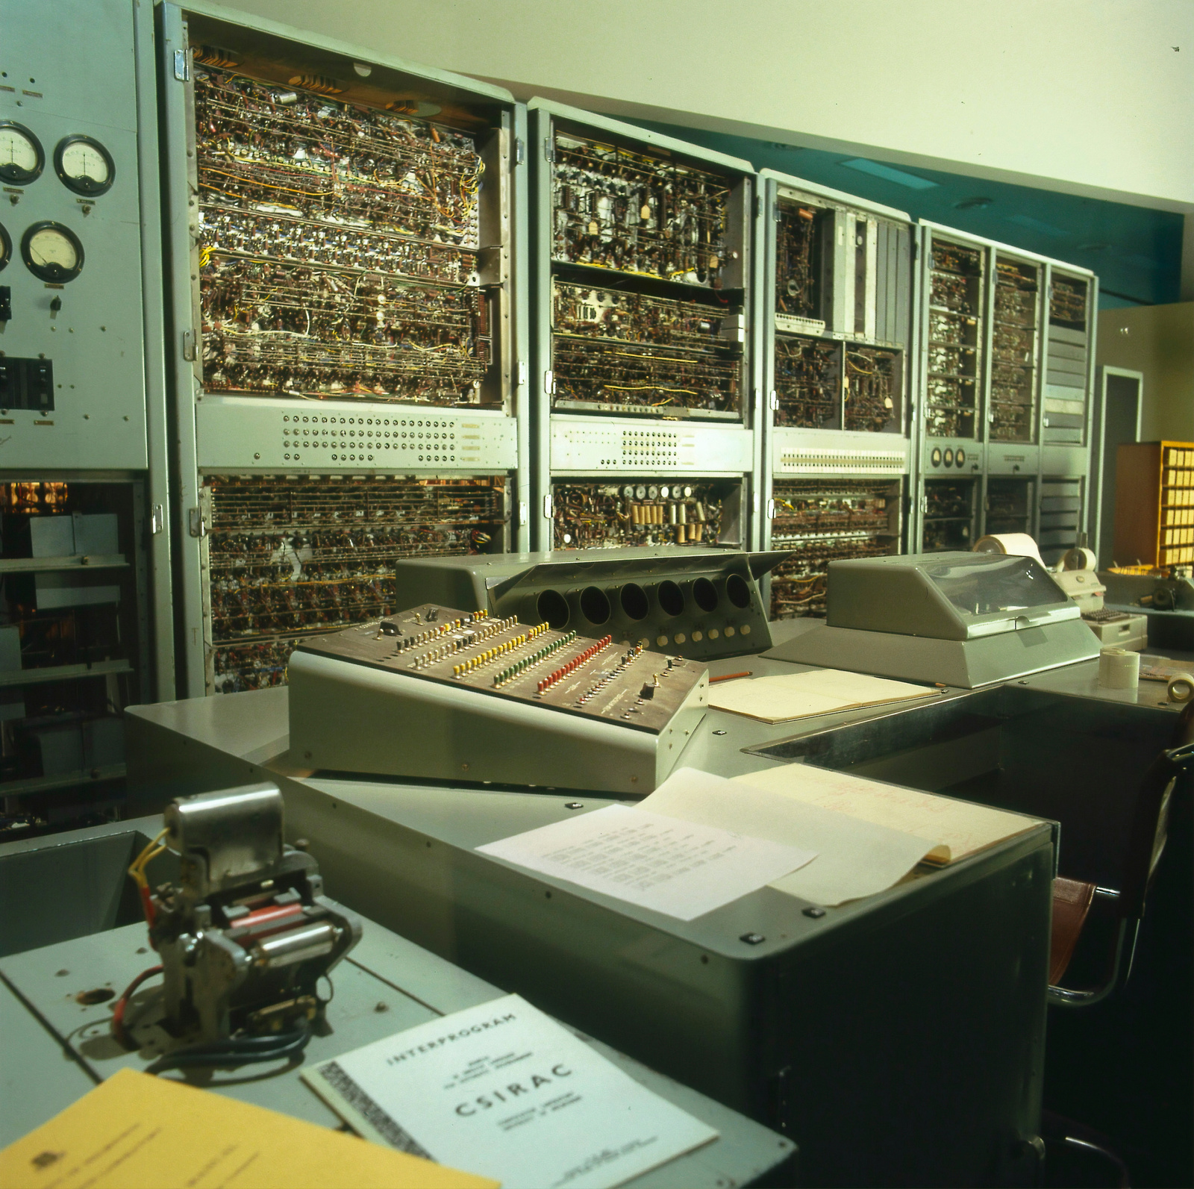

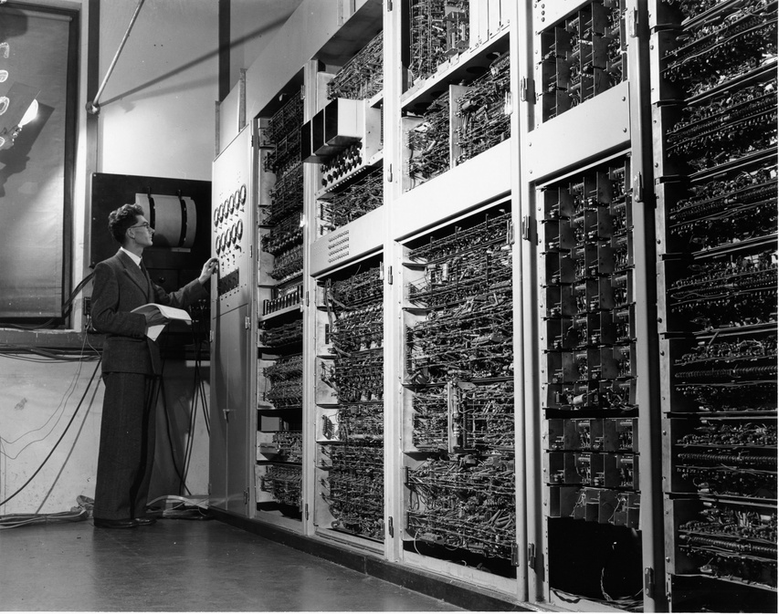

THANK YOU!

